Slide 2
What do you think is one of the biggest threats to democracy?

Slide 3
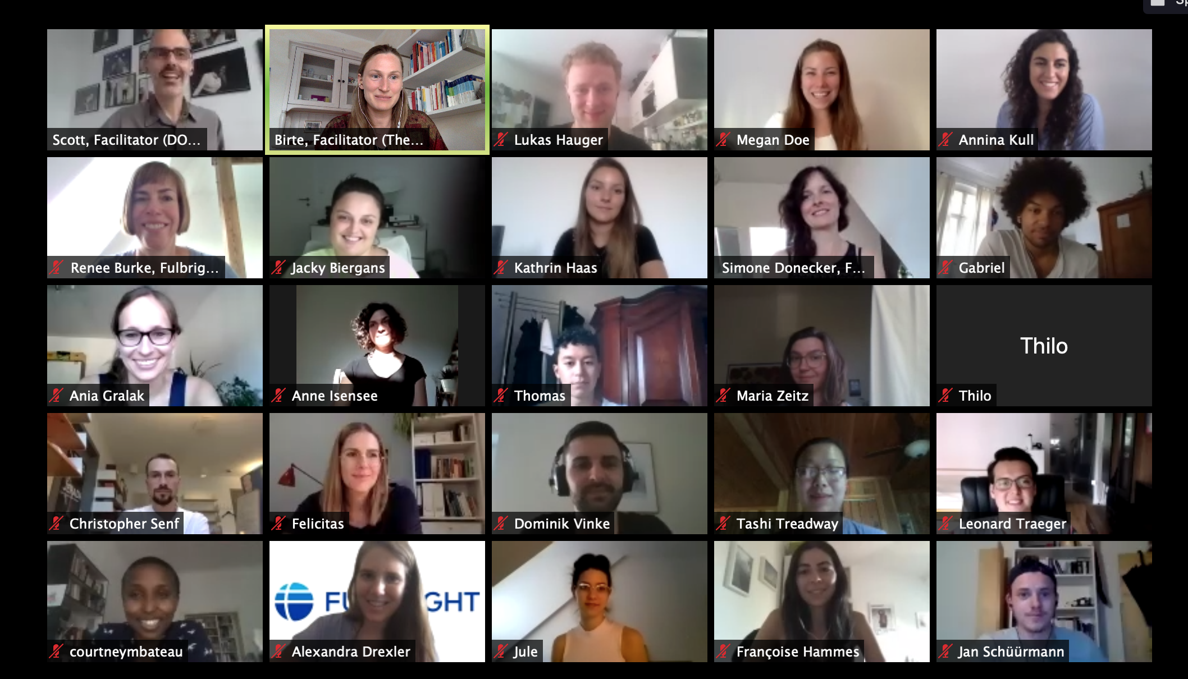

Slide 4
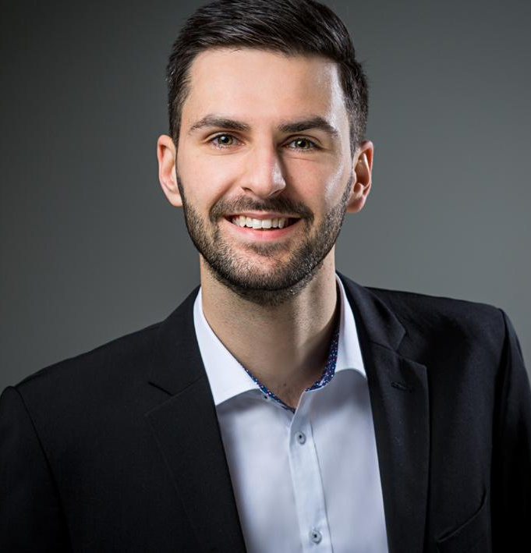
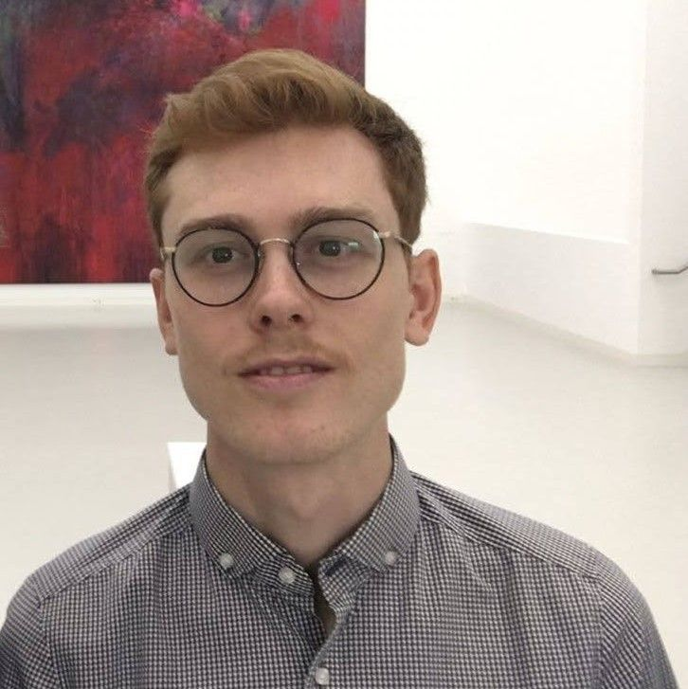
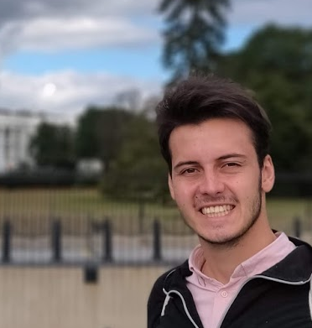
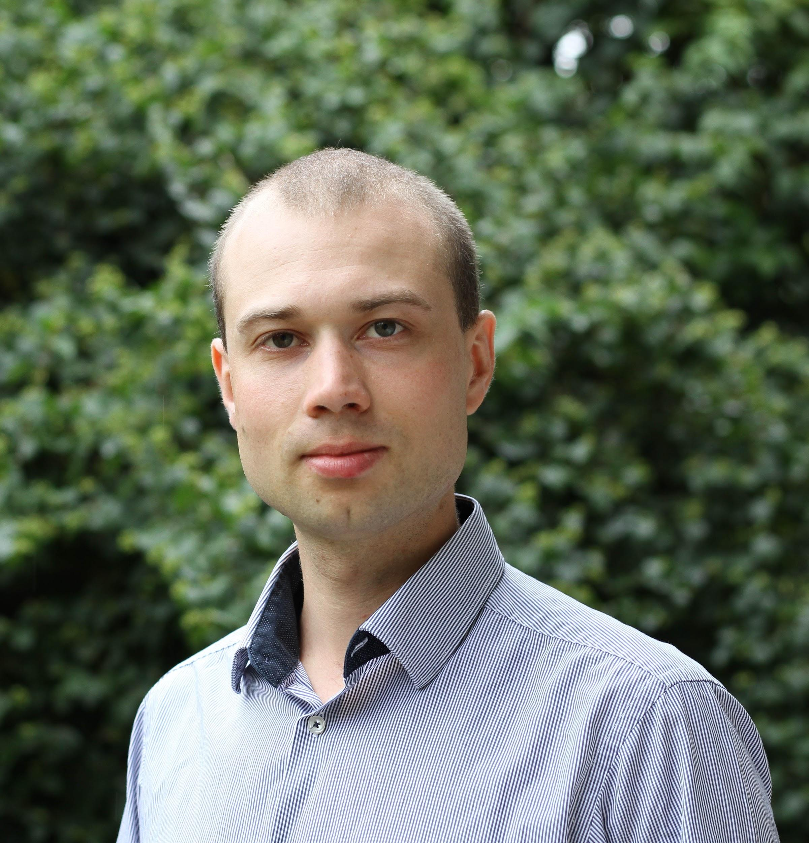
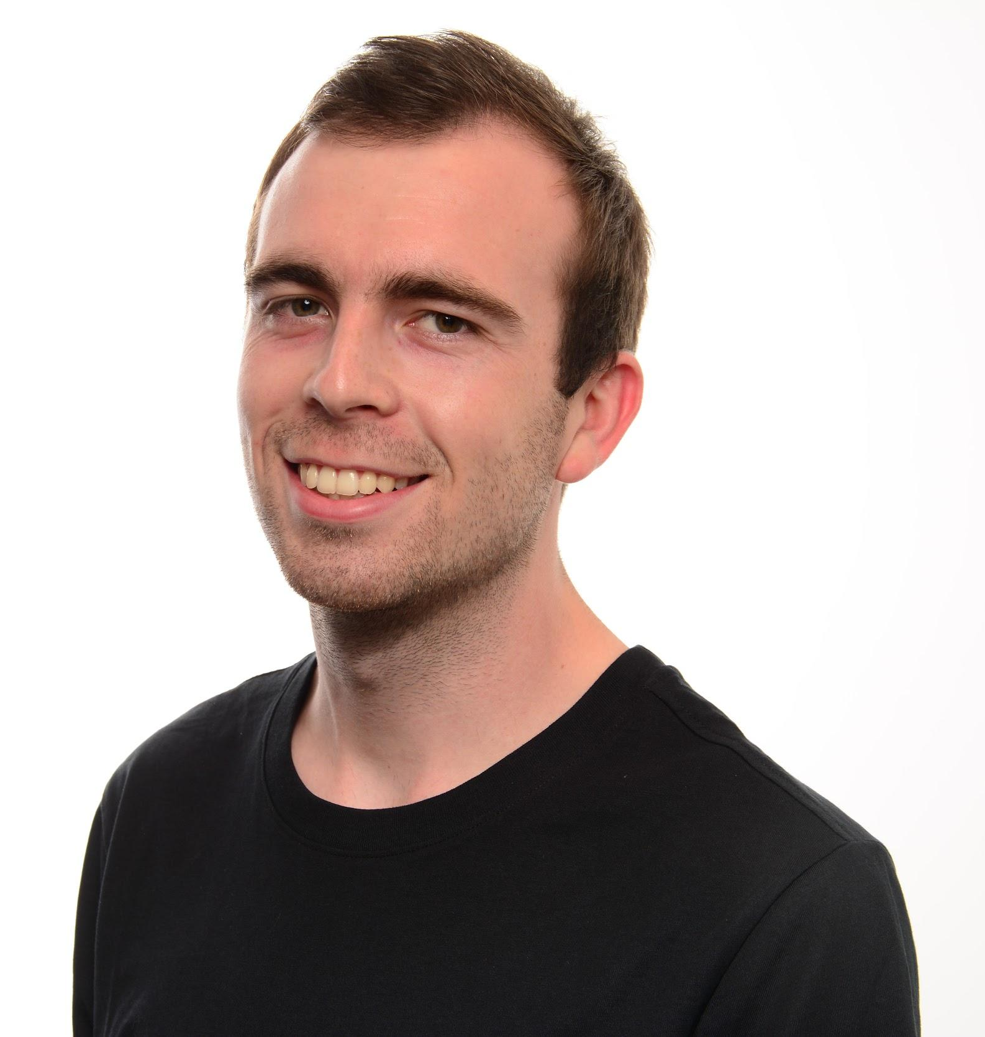
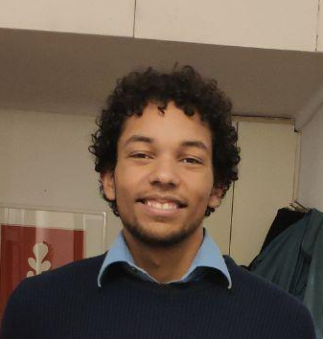
Dominik Vinke
John Brehm
International Management Hochschule Osnabrück University of Florida
Mechanical Engineering
Purdue University
Julian Riedel
Leonard Traeger
Information Systems Technische Hochschule Köln
University of Maryland, Baltimore County
Fine Arts
Staatliche Akademie der Bildenden Künste Karlsruhe
Markus Scholz
Gabriel Kressin
Computer Science Missouri State University
Computer Science
Freie Universität Berlin Johns Hopkins University

Slide 5
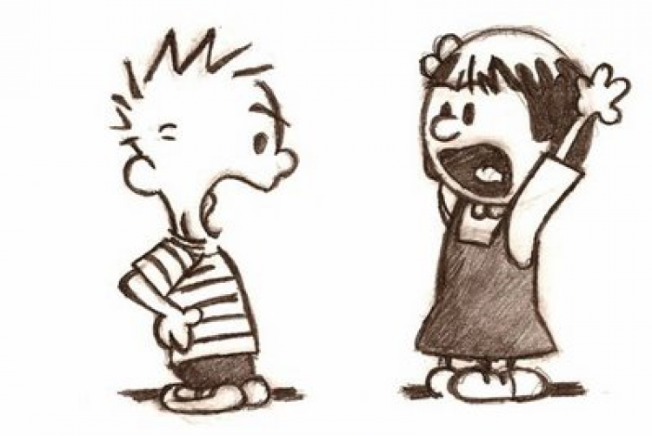
Polarization
Debate identities rather than ideas
No common ground
No understanding of other side

Slide 7

We believe, understanding the other side,
is highly beneficial to democracy and society

Slide 8

>50%
feel misunderstood in political debates¹
¹ Feedback from ViceVersa user survey (n=28)

Slide 9



Share own and understand other experiences
Platform for mutual exchange
Potential to reach many
Notes:
https://www.flaticon.com/free-icon/global_1528621

Slide 10
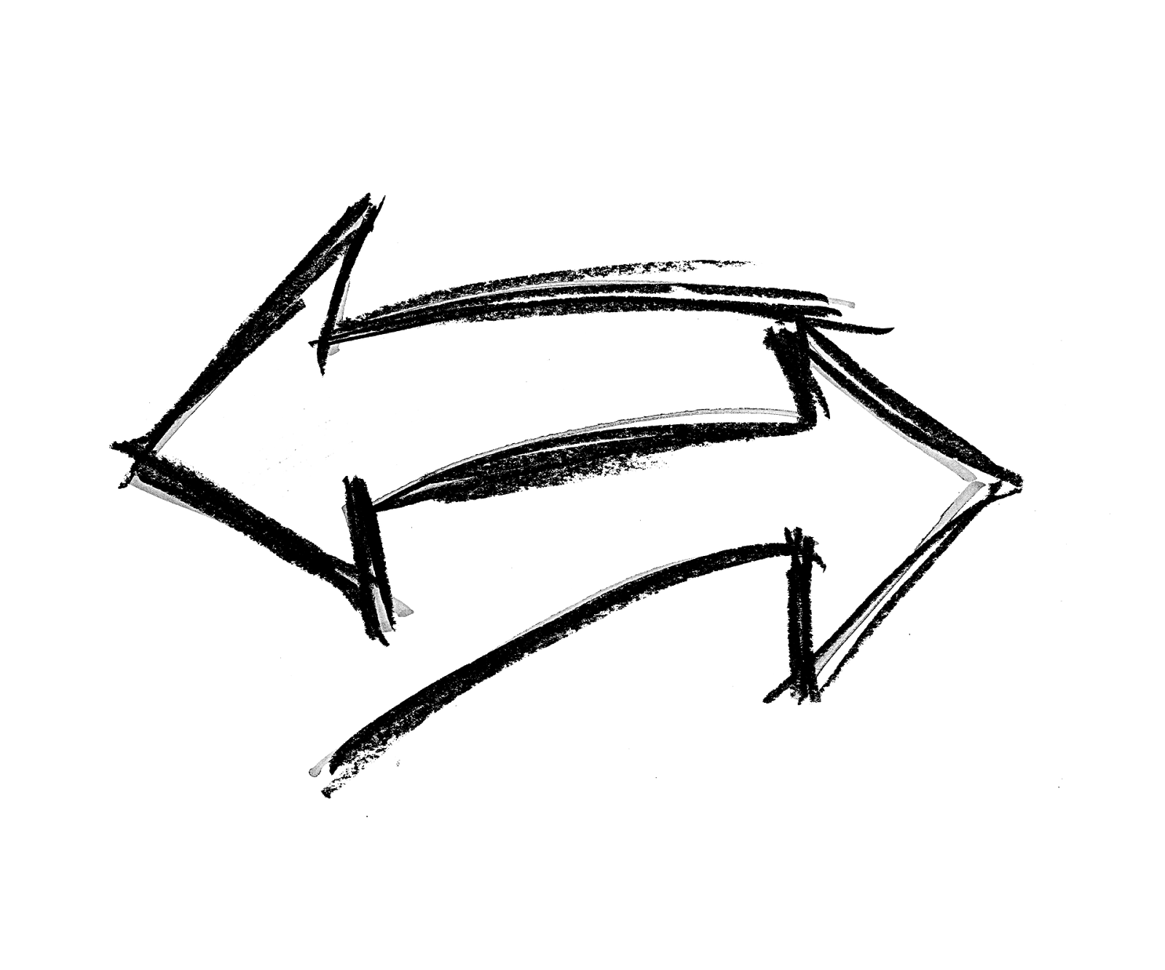
Vice Versa
Foster understanding on a moderated platform
Notes:
Vice Versa – foster understanding on a moderated platform
Vice versa is an app and let‘s jump to the core functions

Slide 11

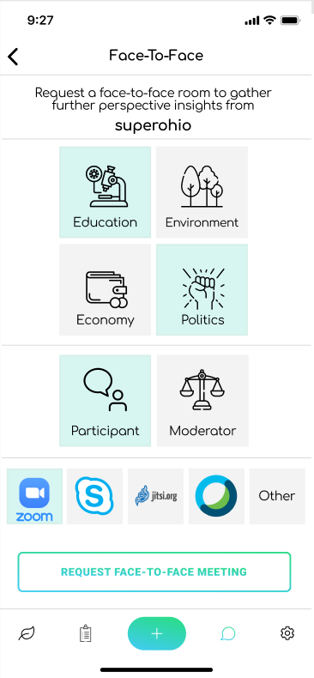
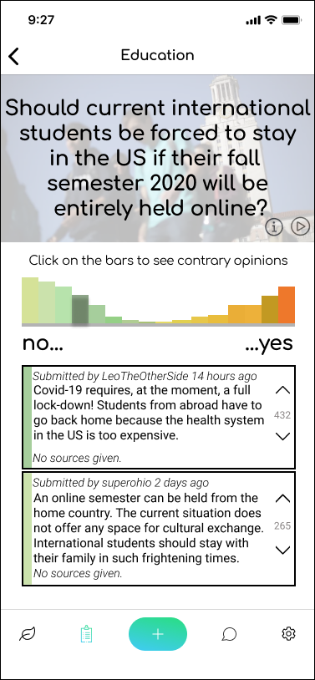
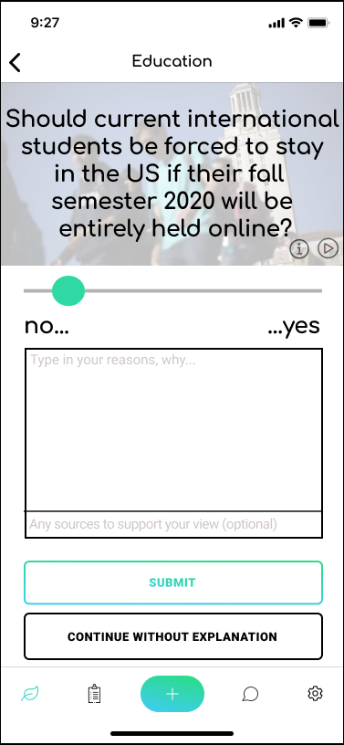
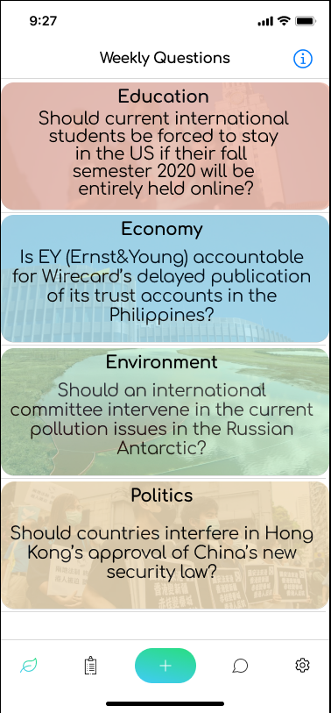
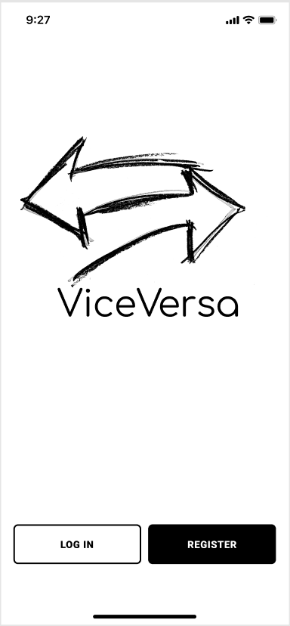
iOS/Android App
Questions
2. Scale & explanation
3. Opinions
4. One-on-one meeting
Note: Preliminary status
Notes:
First of all, you will see highly controversial questions and can choose to dive deep into one: For instance “Should current international students be forced to stay in the US if their fall semester 2020 will be entirely held online?”
Then you’re able to position yourself on a scaling bar and furthermore write your personal explanation – why do you think so?
Afterwards, you see the distribution of every person and the respective explanations – which you then are able to sort, up and downvote
If you became really into one of the explanations, whether they agree with your viewpoint or are highly controversial → just request a one-on-one meeting
What is it, that we think Vice Versa will make a difference to Twitter, Facebook and other known platforms?

Slide 12
Vice Versa
Social Media
Explaining yourself
Convincing others
Showing new opinions
Showing content to increase view time
Democracy engagement
Profit through data
Notes:
What is it, that we think Vice Versa will make a difference compared to Twitter, Facebook and other known platforms?
Instead of convincing others, we want to entirely focus on explaining yourself
Instead of showing content to increase view time we want to show new and insightful opinions
Instead of profit through data, we want to foster democracy engagement
Being able to express yourself while understanding others on a single platform

Slide 13
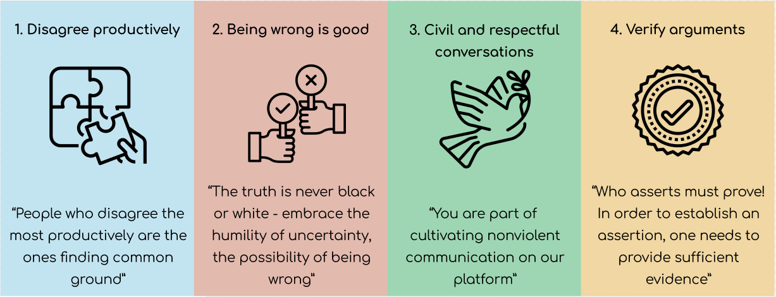
Notes:
Within the only few seconds in which our minds decide about how to solve an actual complex question,
we try - by integrating important elements within the use of our app - to foster an understanding culture where it is fun to detach yourself from rigid viewpoints
We want to keep the user in mind that
people who disagreeing productively are most effective when common ground is found
that being wrong is sometimes good
that in the end, we all are human beings
and the one who assert have to prove.
Within the only few seconds in which our minds decide about how to solve an actual complex question,
we try - by integrating important elements within the use of our app - to foster a understanding culture where it is fun to detach yourself from rigid viewpoints
We want to keep the user’s mind that
people who disagreeing productively are most effective when common ground is found
that being wrong is sometimes good
that in the end, we all are human beings
and the one who assert have to prove.

Slide 14




Clickable Dummy
User Testing and Interviews
Implementation of App
Notes:
Where do we want to end with Vice Versa?
Further work on our Clickable Dummy is needed
Afterwards we will find out whether our assumptions are correct –by finding high qualitative user testing groups (at Uni, Schools in cooperation with political classes, debating forums)
… All that before we go public…
But once the idea and its development has found a (for us) sophisticated status, we will need help and we would like to be able to contact FB again and share our platform

Slide 15
Vice Versa
Foster understanding on a moderated platform
info.viceversa@web.de
Notes:
We think:
“Vice Versa has potential”
The people behind Vice Versa are dedicated to foster understanding

Slide 16
Dominik Vinke
John Brehm
International Management Hochschule Osnabrück University of Florida
Mechanical Engineering
Purdue University
Julian Riedel
Leonard Traeger
Information Systems Technische Hochschule Köln
University of Maryland, Baltimore County
Fine Arts
Staatliche Akademie der Bildenden Künste Karlsruhe
Markus Scholz
Gabriel Kressin
Computer Science ???
Computer Science
Freie Universität Berlin Johns Hopkins University

